Slide 1
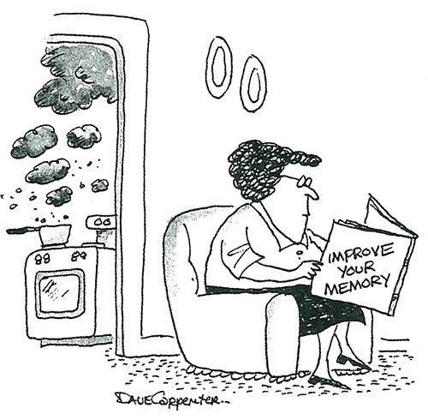

MEMORY
Notes:
O Logo de espadas deve ter mais espaço das pontas abaixo. Sugerir outros tipos de imagens/ telefone, fones.

Slide 2
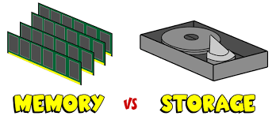
MEMORY & STORAGE
MEMORY : Provides your working space (Ex. RAM,ROM).
STORAGE : Provides capacity for all the files and information you need. (Ex: hard disk, Optical disk, USB).

Slide 3
MEMORY
The physical devices used to store the data either temporarily or permanently.
Data is stored in binary format.
Types :
RAM
ROM
Cache memory

Slide 4
RAM
Random Access Memory
Used as a temporary storage because it is volatile.
Allows the user to read or write the data at the same amount of time.
Types
SRAM
DRAM

Slide 5
SRAM vs. DRAM
STATIC RANDOM ACCESS MEMORY | DYNAMIC RANDOM ACCESS MEMORY
Semi conductor memory | Store each bit of memory in capacitor in an integrated circuit
Uses flip-flop to store each bit of memory | Uses a pair of transistor and a capacitor to store the data.
Need to be refreshed frequently. | Doesn’t required to refresh frequently.
6 transistors per bit | Single transistor per bit.
Faster and consumes less power. | Slower and consumes more power than SRAM.

Slide 6
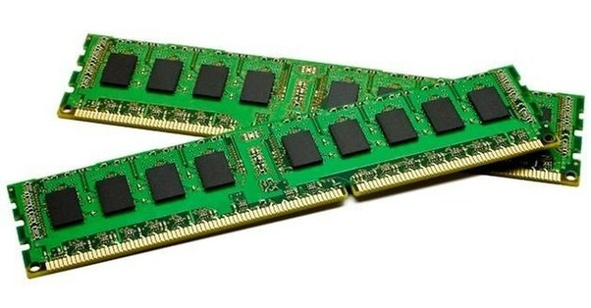
Read Only Memory
A storage medium used to store the data permanently.
Mainly used for firmware, programs to start PC, Boot settings.
Types
PROM
EPROM
EEPROM

Slide 7
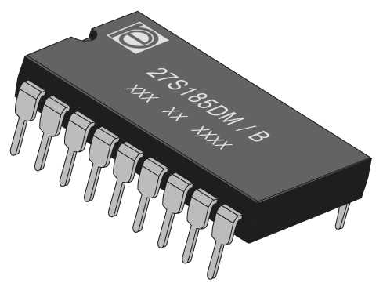
TYPES OF ROM
PROM
EPROM
EEPROM
Programmable ROM
It is empty when manufactured. This complete empty space can be used by the user and cant be erased once used.
Erasable PROM
Programmed with the use of very high voltages and exposure to approx. 20 minutes of intense ultraviolet (UV) light. The data in the chip can be erasable.
Electrically Erasable PROM
Same as EPROM, here the data can be erased electrically as many times according to the requirement.

Slide 8
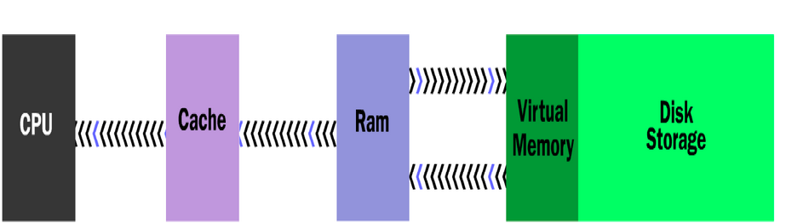
CACHE MEMORY
Typically integrated directly into the CPU chip or placed on a separate chip that has a separate bus interconnect with the CPU.
Used to store program instructions and data that are used repeatedly in the operation of programs or information that the CPU is likely to need next.
Improves computer’s performance.
Types :
L1 : Primary cache
L2 : Secondary cache
L3 : Specialized cache

Slide 9
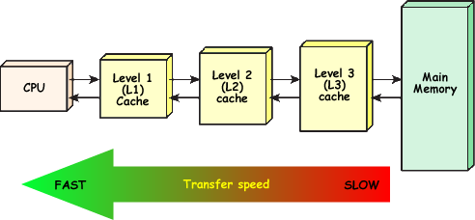
CACHE TYPES
L1: Primary cache
L2: Secondary cache
L3: Specialized memory
Extremely fast and small.
Usually embedded in the processor chip as a CPU cache.
Capacity: 8Kb-128Kb.
Slower than L1
Embedded on CPU directly.
Capacity: 64Kb-16Mb.
Slowest of all.
Developed to improve L1&L2 performance.
Separated from processor chip on the motherboard.

Slide 10

STORAGE
Notes:
O Logo de espadas deve ter mais espaço das pontas abaixo. Sugerir outros tipos de imagens/ telefone, fones.

Slide 11
STORAGE DEVICES
Any computing hardware that is used for storing, porting and extracting data files and objects even when the power is off.
Ex: Floppy disk drive, hard disk drive, USB flash disk,...
It can hold and store information both temporarily and permanently, and can be internal or external to a computer, server or any similar computing device.
Types :
Optical storage
Magnetic storage
Flash memory device

Slide 12
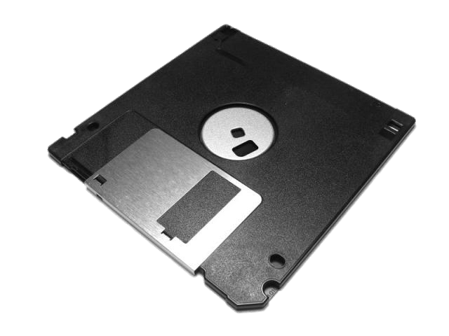
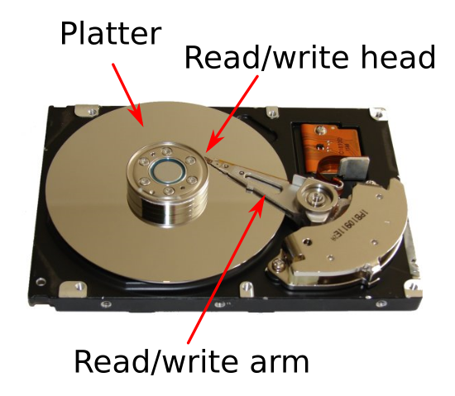
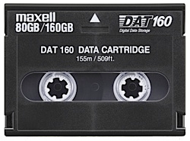
Magnetic Storage

Slide 13
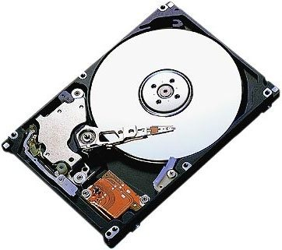
Hard Disk Drive
First introduced in 1956
Max. capacity: 4 TB
Continuously improved.
Connected to systems by standard interface cables such as :
PATA (Parallel ATA)
SATA (Serial ATA)
USB or SAS (Serial Attached SCSI).

Slide 14
FLOPPY DISK
A removable magnetic storage medium
First introduced in 1967
Read and written by Floppy Disk Drives(FDD)
Discontinued usage
Types :
8”
5.5”
3.5”

Slide 15



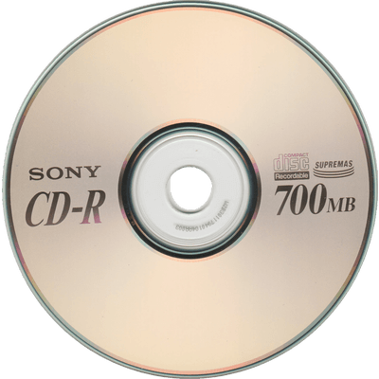
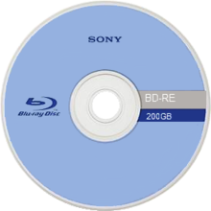
OPTICAL STORAGE
Compact Disc (CD)
Capacity: 700MB
Available from 1982
DVD
Capacity: 4.7 GB
Available from 1995
Blu-ray Disc
Capacity: 25 GB
Available from 2006

Slide 16
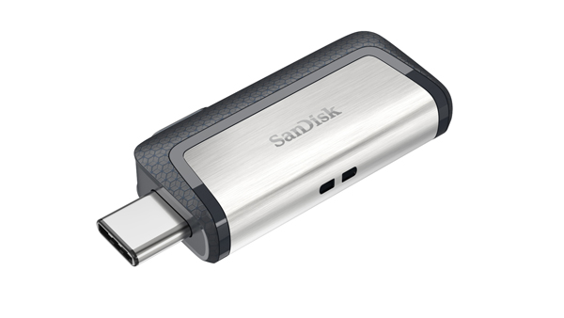
FLASH MEMORY DEVICES
Developed in 1980.
Non-volatile storage medium that can be electrically erased and reprogrammed.
USB Flash Drive
Commercially available in 2000
Max. capacity: 1 TB.
Small in size
Ideal solution for storing data.

Slide 17
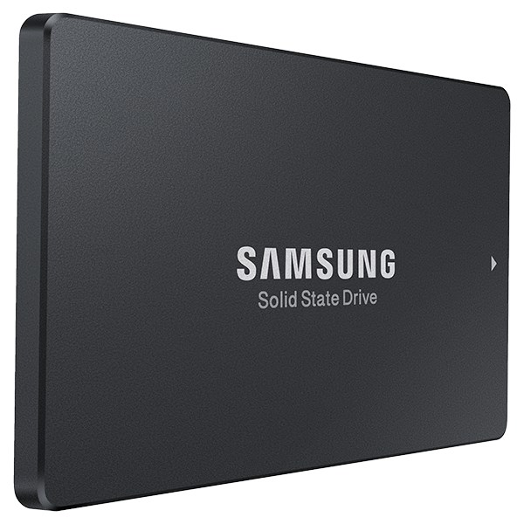
SOLID STATE DRIVE
Introduced in 1995.
Max. capacity: 1 TB.
Very high transferring speed.

